Slide 1
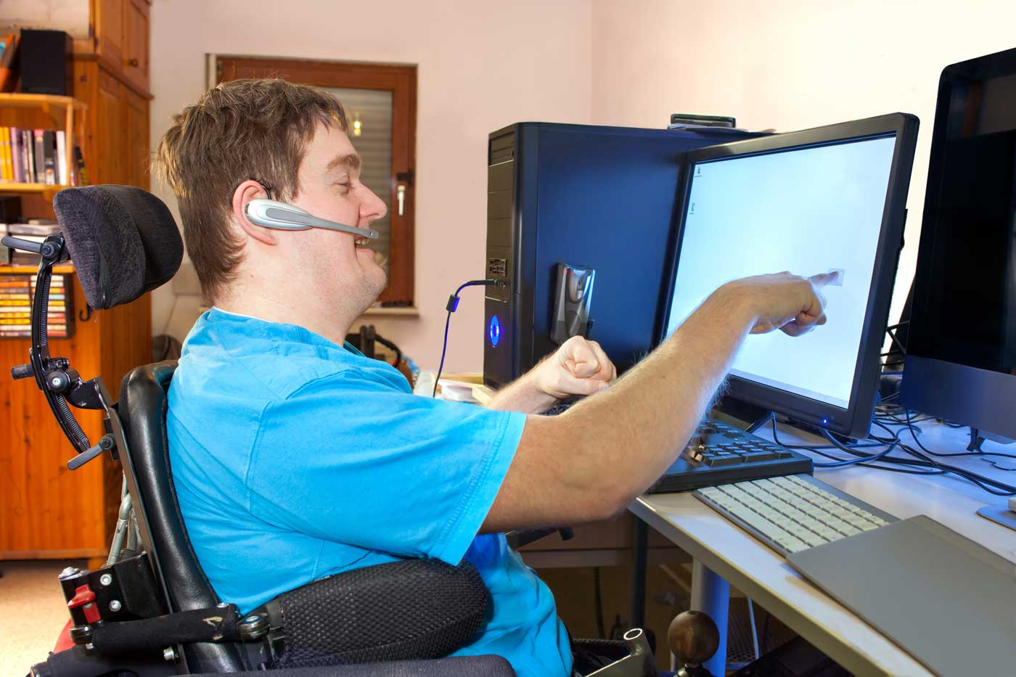

Competitive Integrated Employment for People with Physical Disabilities
Module 1
Notes:
Thank you for joining the Employment for People with Physical Disabilities Module 1 training. This training was developed with funding by the Wisconsin Department of Health Services.

Slide 2

The development of this training was funded by the Wisconsin Department of Health Services as part of their competitive integrated employment (CIE) training series in partnership with Employment Resources, Inc. (ERI).
Notes:
The development of this training was funded by the Wisconsin Department of Health Services as part of their competitive integrated employment (CIE) training series in partnership with Employment Resources, Inc. (ERI).

Slide 3

What You Will Learn
Employment statistics for people with physical disabilities
Definition of physical disability and physical disability statistics in Wisconsin
Employer benefits from hiring people with disabilities
How unemployment and low income affect physical and mental health
Identification of common employment barriers people with physical disabilities experience
Notes:
People with physical disabilities can face many obstacles when pursuing employment.
In Module 1 of this training, you will learn
Employment statistics for people with physical disabilities
The definition of physical disability and physical disability statistics in Wisconsin
How employers benefit from hiring people with disabilities
How unemployment and low income affect physical and mental health and
Identification of common employment barriers people with physical disabilities experience.

Slide 4
Employment Rates
For People with Physical Disabilities in Wisconsin
Notes:
Employment Rates for People with Physical Disabilities in Wisconsin.

Slide 5

Employment Rates for People with Disabilities
19%
Long-Term Care Participants
of People with Disabilities Are Employed in Wisconsin
More Barriers
Lower Employment Rates
Notes:
Employment rates for people with disabilities are significantly lower than people without disabilities. In Wisconsin, only 19% of people with disabilities are employed (Source: Bureau of Labor Statistics 2021).
People with disabilities who are enrolled in long-term care programs experience more significant barriers to employment and are employed at rates below the state average.
Note: Need to reference new data report when it is released by DHS

Slide 6

People with Physical Disabilities Have Significantly Lower Employment Rates
19%
1%
of People with Disabilities Are Employed in Wisconsin
of People with Physical Disabilities Are Employed in Wisconsin
Notes:
Approximately 20,500 people with physical disabilities are enrolled in Family Care and IRIS (According to November 2022 Family Care and December 2022 IRIS enrollment reports on the Department of Health Services website). Wisconsin Department of Health Services data from 2022 indicates only 1% of working-age people with physical disabilities in Family Care and IRIS are employed. These low numbers do not mean that people with physical disabilities in Wisconsin’s long-term care programs do not want to work.
Note: Need to reference new data report when it is released by DHS

Slide 7
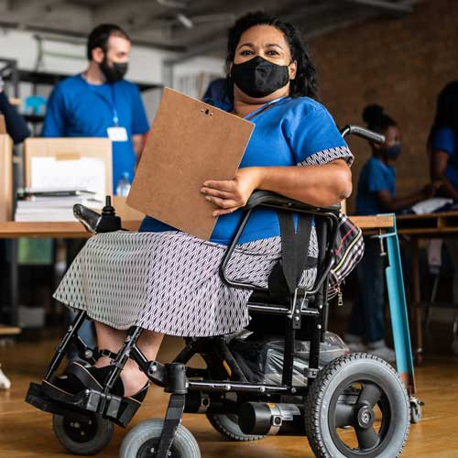
People with Physical Disabilities Want to Work
47%
Wanted to Work Pre-Pandemic
39%
Wanted to Work During Pandemic
Notes:
According to Wisconsin’s National Core Indicator data from 2018-2019, 47% of respondents with physical disabilities in Family Care, Family Care Partnership, and IRIS who were not currently employed indicated they would like a job. This number decreased during 2019-2020. However, 39% of respondents continued to indicate a desire to work, despite being amid a pandemic.

Slide 8

People with Disabilities Are a Valuable Untapped Talent Pool for Employers
Notes:
Imagine if every person with a physical disability in Family Care and IRIS was supported to obtain employment. This means more than 9,000 people with physical disabilities would enter Wisconsin’s workforce. During an era of workforce shortages, Family Care, Family Care Partnership, and IRIS members represent a valuable untapped talent pool for employers.

Slide 9


Contributors to Low Employment Rate for People with Physical Disabilities
Lack of access to employment supports
Underfunded
Unavailable
Notes:
One major contributor to the extremely low employment rates for people with physical disabilities in long-term care has been the historical lack of access to employment supports. Prior to Home and Community Based Waiver Services (HCBS) programs like Family Care, Family Care Partnership, and IRIS people with physical disabilities with long-term care needs enrolled in the Community Options Program (COP). COP services were significantly underfunded or unavailable in most counties. Recipients of COP funding received limited services. To access employment supports, people would have to shift services away from other areas of critical need, such as supportive home care or personal care if they wanted employment supports.

Slide 10
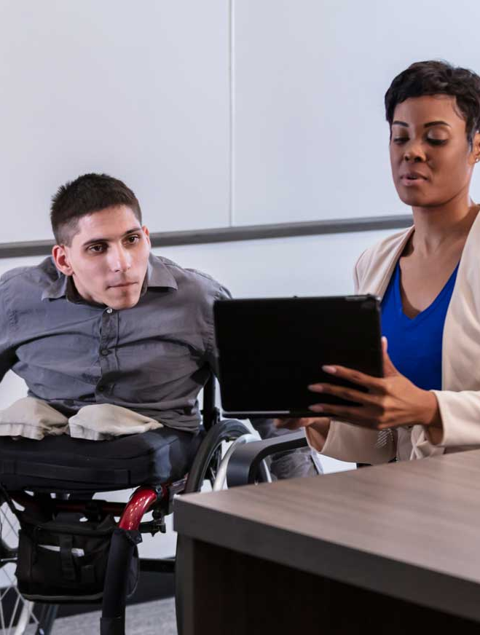
Family Care, Family Care Partnership, and IRIS Opened Access to Employment Services
Vocational Futures Planning and Support
Supported employment
Work Incentives Benefits Counseling
Adaptive aids
Transportation
Workplace personal assistance
Self-directed personal care on the job
Notes:
Family Care, Family Care Partnership, and IRIS replaced the COP waiver program and ended waiting lists across Wisconsin. People with physical disabilities gained access to a full array of employment services they did not have before. These services include Vocational Futures Planning and Support, Supported Employment, Work Incentives Benefits Counseling, Adaptive Aids, Transportation, Workplace Personal Assistance, and Self-Directed Personal Care on the job. Availability of these services presents a tremendous opportunity to support thousands of people with physical disabilities in long-term care who want to work to achieve their goals! Module three will explain these services in more depth. Knowing about these services will enable you to do your part in helping people with physical disabilities on their path to employment.
Let’s take a closer look at the unique circumstances of people with physical disabilities.

Slide 11
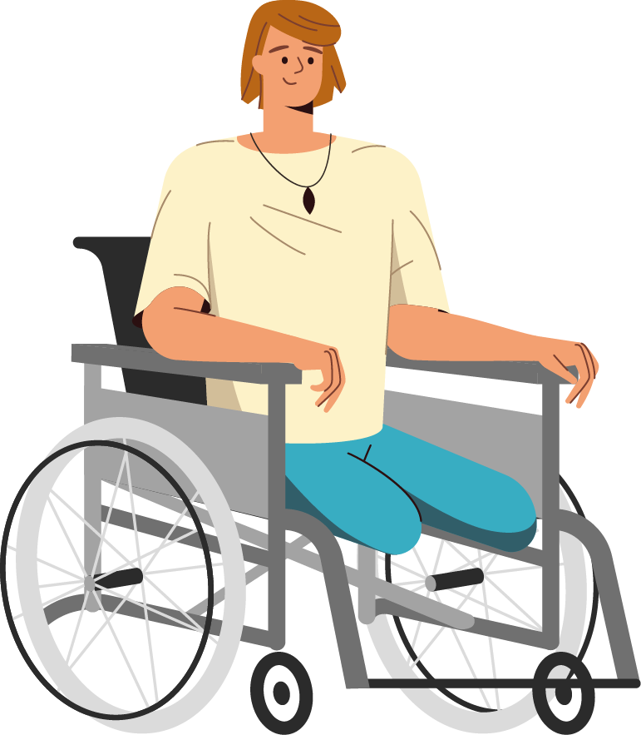
What Is a Physical Disability?
Notes:
What Is a Physical Disability?

Slide 12

Physical Disability Defined
Physical condition including:
Anatomical loss
Musculoskeletal
Neurological
Respiratory
Cardiovascular impairment
Significantly interferes or limits at least one major life activity of a person
Notes:
Physical disability is defined in the Wisconsin Statutes as a physical condition, including an anatomical loss, or musculoskeletal, neurological, respiratory, or cardiovascular impairment, which results from injury, disease, or congenital disorder and which significantly interferes with or significantly limits at least one major life activity of a person.

Slide 13
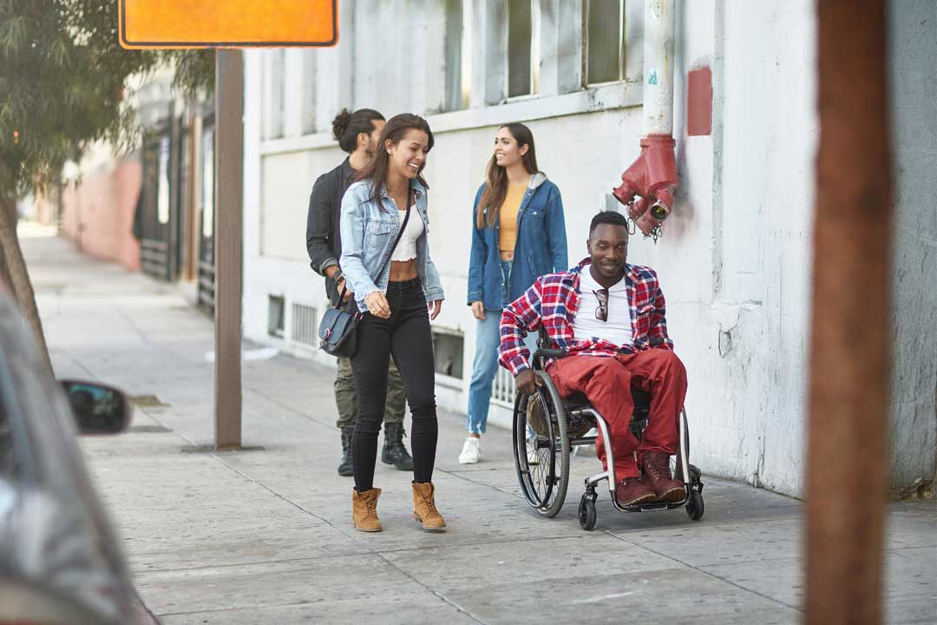
Major Life Activities
Self-care
Performance of manual tasks not related to employment
Walking
Receptive and expressive language
Breathing
Working
Participating in educational programs
Mobility – other than walking
Capacity of independent living
Notes:
Major life activity means any of the following: self-care, performance of manual tasks unrelated to gainful employment, walking, receptive and expressive language, breathing, working, participating in educational programs, mobility–other than walking, and capacity for independent living.

Slide 14
Examples of Conditions Meeting the Definition of a Physical Disability
arthritis
cancer
amputation
multiple sclerosis
heart and lung disease
polio
spinal cord injuries
muscular dystrophy
And other disabilities or medical conditions that meet this criteria as outlined in state statute.
Notes:
This definition would include people with an amputation, arthritis, cancer, heart and lung disease, multiple sclerosis, muscular dystrophy, polio, spinal cord injuries and other disabilities or medical conditions that meet this criteria as outlined in state statute.

Slide 15

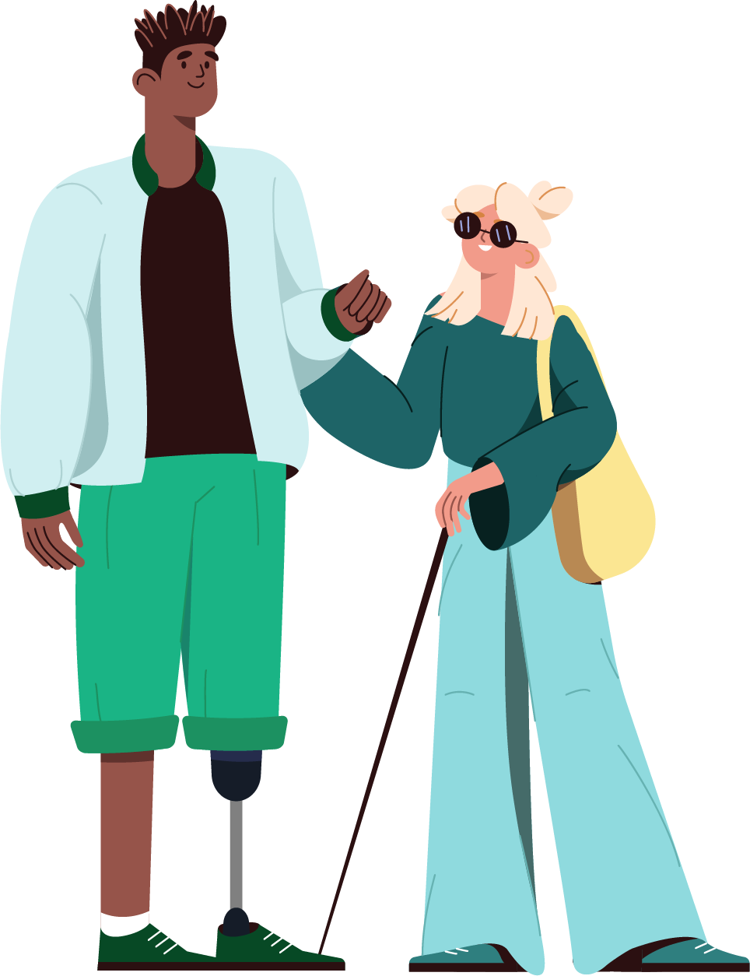
People in Wisconsin with Physical Disabilities
Notes:
Let’s look at how many people in Wisconsin have physical disabilities.

Slide 16
Physical Disability – A Broader Definition
Impairments that limit facets of daily living:
Respiratory disorders
Blindness
Epilepsy
Sleep disorders
Not only people in a wheelchair or people using canes, crutches, or walkers
People with limits to their physical functioning, mobility, dexterity, or stamina
Notes:
It is difficult to determine how many people have physical disabilities in Wisconsin because of a lack of targeted data collection. Coupled with this is the inability to predict who may need support services.
The definition of physical disability in Wisconsin includes people who do not fit into the commonly held image of a person in a wheelchair or individuals using a cane, crutches, or walker.
A physical disability may include limits to a person’s physical functioning, mobility, dexterity, or stamina. Physical disabilities may include impairments which limit other facets of daily living, such as respiratory disorders, blindness, epilepsy, and sleep disorders.

Slide 17

Disability Prevalence in Wisconsin
Types of Disability with Physical Difficulties:
11.8% or 677,631
4.1% (142,184 people) ambulatory
people reporting at least one disability
1.7% (58,774 people) self-care
3.3% (116,692 people) independent living
Notes:
The 2020 Census Bureau’s American Community Survey (ACS) provides recent information about prevalence of disability in Wisconsin. In 2019, Wisconsin’s total non-institutional population was 5,735,703 with about 11.8% or 677,631 people reporting at least one disability.
4.1% (142,184 people) have an ambulatory difficulty – meaning difficulty in walking about.
1.7% (58,774 people) have a self-care difficulty such as trouble with doing activities like dressing, bathing, or getting around inside the home.
3.3% (116,692 people) have an independent living difficulty or challenges in performing instrumental activities of daily living like grocery shopping or visiting a doctor's office alone.

Slide 18
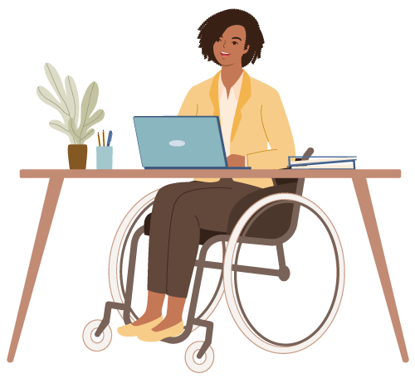
The Benefits of Employment
Notes:
The Benefits of Employment.

Slide 19

The Disability Inclusion Advantage
Employers are seeing the benefits of hiring people with disabilities
Source: The Disability Inclusion Advantage
Notes:
One of the barriers to employment for people with disabilities is businesses do not understand the talents and benefits of hiring them. In addition, misconceptions about the cost of hiring people with disabilities versus the advantages prevail. However, public service and government sponsored workforce campaigns, news articles, and social media promoting employment for people with disabilities have been increasing in recent years. A growing number of employers are seeing the benefits of hiring people with disabilities.
Source: The Disability Inclusion Advantage. All resources and links can be found in the resources section of this training.

Slide 20

People with Disabilities Are Reliable, Talented Employees
Businesses who hire people with disabilities:
Outperform businesses who do not prioritize hiring people with disabilities
Have higher profit margins
Experience better employee retention and turnover rates
Increase workplace diversity, creativity, and innovation
Notes:
Research over the past 20 years has demonstrated that people with disabilities are reliable, talented employees. Businesses who hire people with disabilities outperform businesses that do not prioritize hiring people with disabilities. They have higher profit margins and experience significantly better employee retention and turnover rates.
Employees with disabilities contribute to workplace diversity, creativity, and innovation. A 2018 Accenture report identified six key areas of “inclusion incentives” for employers that hire people with disabilities, including increased innovation, improved shareholder value, improved productivity, access to new and diverse suppliers, improved market share, and enhanced reputation.

Slide 21

Unemployment and Low Income Affect Physical and Mental Health
Those who are unemployed report feelings of depression, anxiety, low self-esteem, demoralization, worry, and physical pain. Unemployed individuals tend to suffer more from stress-related illnesses such as high blood pressure, stroke, heart attack, heart disease, and arthritis.
Source: The U.S. Department of Health and Human Services literature summary for the Healthy People 2030
Notes:
Hiring people with disabilities is beneficial to employers and being unemployed negatively impacts people with disabilities.
Several studies have linked poor health and mental health to unemployment. The U.S. Department of Health and Human Services literature summary for the Healthy People 2030 initiative indicates:
Those who are unemployed report feelings of depression, anxiety, low self-esteem, demoralization,^{6,8} worry, and physical pain.³³ Unemployed individuals tend to suffer more from stress-related illnesses such as high blood pressure,^{34,35,36,37} stroke, heart attack, heart disease, and arthritis.^{8,38,39}
Source: The U.S. Department of Health and Human Services literature summary for the Healthy People 2030

Slide 22
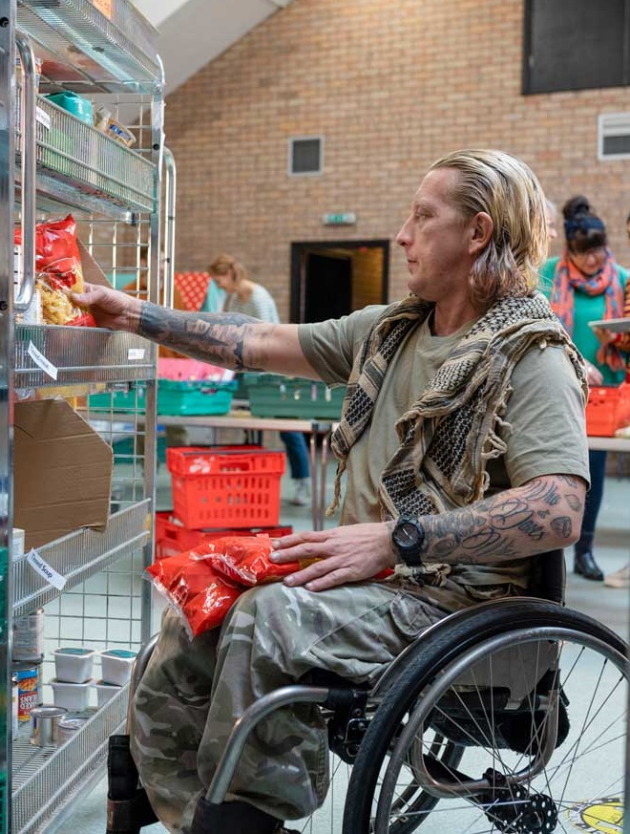
People with Significant Disabilities Who Rely on Public Benefits Live in Poverty
A single person receiving a full Supplemental Security Income or SSI payment receives approximately $900 per month in 2023
Social Security Disability Insurance or SSDI payments range on average from $800 to $1800 per month in 2023
Notes:
Exclusion from the workforce for people with disabilities usually means reliance on public benefit programs such as Supplemental Security Income (SSI) and Social Security Disability Insurance (SSDI). A single person receiving a full SSI payment receives approximately $900 per month in 2023. Social Security Disability Insurance or SSDI payments range on average from $800 to $1800 per month in 2023.
People with disabilities may also have additional costs for long-term health care, personal assistants, adaptive and personal care equipment, and other disability related costs. This means most people with significant disabilities who rely on public benefits live in poverty.

Slide 23
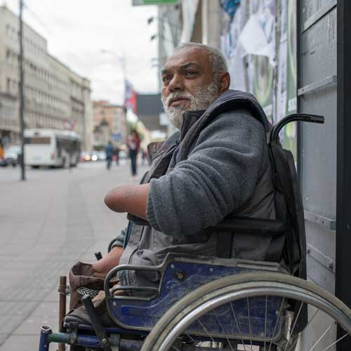


Poverty and Disability Go Hand in Hand
Poverty and economic insecurity can limit access to
Disability or illness can lead to
job loss and reduced earnings, barriers to education and skills development, significant additional expenses, and other challenges leading to economic hardship.
health care and preventative services increasing the likelihood of living and working in an environment which adversely affects health.
Notes:
The Center for American Progress 2015 publication “A Fair Shot for Workers with Disabilities” describes the relationship between disability and poverty as “both a cause and consequence of economic insecurity:”
It is a cause because disability or illness can lead to job loss and reduced earnings, barriers to education and skills development, significant additional expenses, and many other challenges that can lead to economic hardship. It can also be a consequence because poverty and economic insecurity can limit access to health care and preventive services and increase the likelihood that a person lives and works in an environment that may adversely affect health. As a result, poverty and disability go hand in hand.

Slide 24
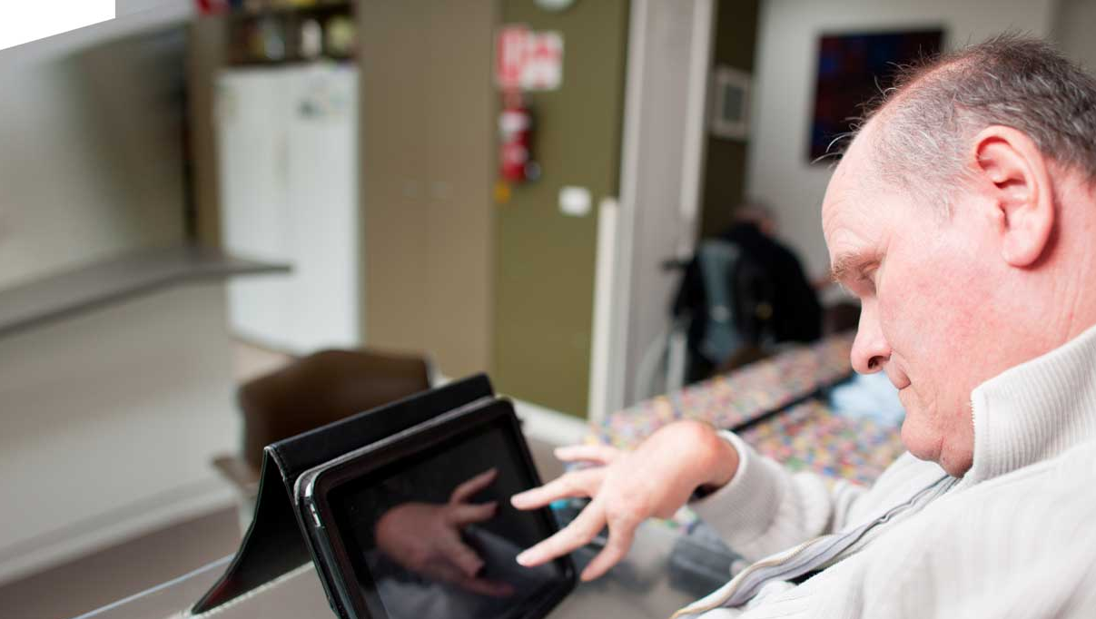
Providing Effective Supports for People with Disabilities to Obtain and Maintain Employment Leads to Better Economic and Health Outcomes
Notes:
Providing effective supports for people with physical disabilities to obtain and maintain employment will lead to better economic security and improved health outcomes. However, a number of barriers can make this goal challenging. Let’s look at some of these barriers.

Slide 25
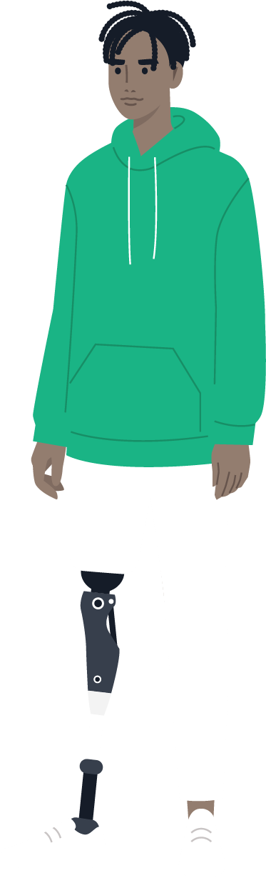

Common Employment Barriers Experienced by People with Physical Disabilities
Notes:
Here are some of the most common employment barriers experienced by people with physical disabilities.

Slide 26






Exploring Barriers
Choose a barrier to learn more about it.
Managing Health and Service Needs
Need for Personal Care Assistance
Access to Transportation, Especially Accessible Transportation
Identifying Career Opportunities
Navigating Complex Benefit Programs
Employer Attitudes and Negotiating Accommodations
Next Section
Notes:
People with physical disabilities face multiple barriers to employment. Addressing these barriers can feel overwhelming, making the idea of having a job seem impossible. Let’s explore some of these barriers to get insight into what may be preventing people with physical disabilities from pursuing employment.
Choose a barrier to learn more about it.

Slide 27

Managing Health and Service Needs
Explore More Barriers
Notes:
People with physical disabilities often spend a great deal of time managing their health, attending medical appointments, and coordinating their service needs. The task is a daunting one, requiring significant amounts of time and energy. Adding additional activities and services to find employment may seem like too much to coordinate.

Slide 28
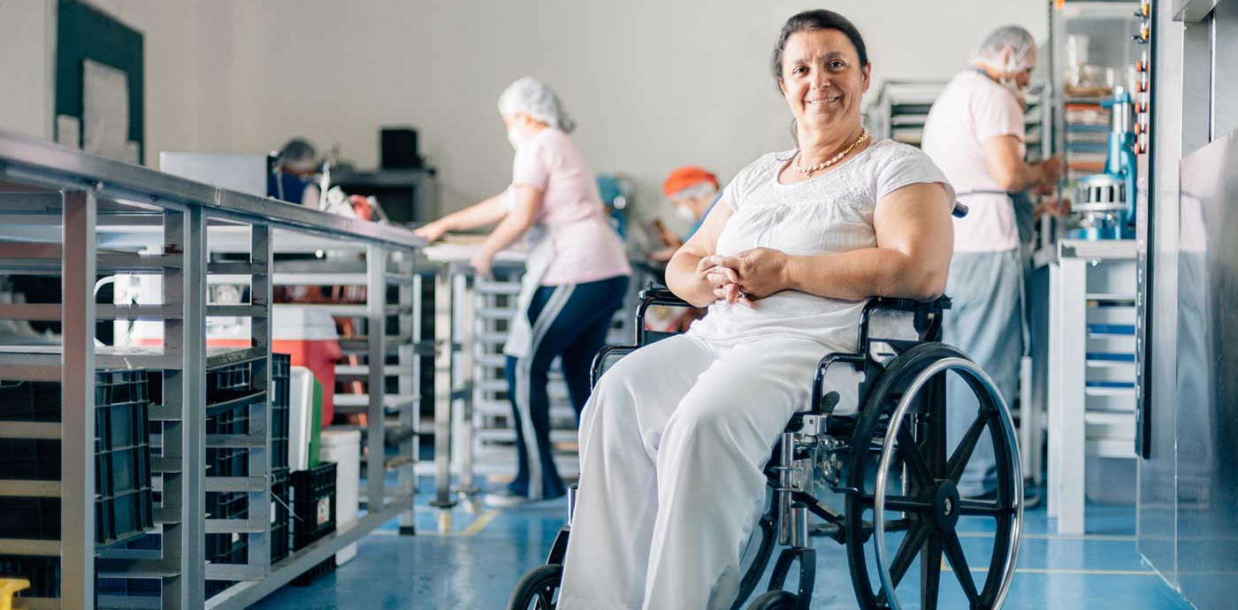
Identifying Career Opportunities
Explore More Barriers
Notes:
People with physical disabilities can have difficulty conceiving potential employment where both their interests and limitations could be accommodated. For a person with an acquired disability, their concept of work might be what they did before the onset of a disability. Because of this, work might seem impossible now. For example, a person who was carpenter before acquiring a spinal cord injury may say he is not able to work because he can no longer do the work he used to do. To address a person’s perceptions about what they are able to do for work may take exploration to find a new career path or training to learn new skills or use adaptive equipment.

Slide 29






Navigating Complex Benefit Programs
Explore More Barriers
Notes:
Many people with significant physical disabilities qualify for health and/or long-term care from Medicare and/or Medicaid, and earned income replacement from Social Security Disability Insurance (SSDI), Supplemental Security Income (SSI), Workers’ Compensation, and/or Unemployment Compensation. A significant number of people also require additional benefits from the Supplemental Nutrition Assistance Program (SNAP), Housing and Urban Development (HUD) Section 8 rent subsidies and similar “safety net” programs. All these benefits are affected by earned income and have a different set of rules and regulations governing them.
Many people with physical disabilities in the long-term support system have waited years to get the community-based supports upon which they now rely. During those years of waiting, some individuals had no choice but to live in a nursing facility, and now that they are living in the community they do not want to lose their independence. For them, the “safety net” includes the benefits, resources, and services secured after being on endless waiting lists, filling out lengthy applications, and waiting for a disability determination that may take months to complete. People with significant physical disabilities will likely have a lifelong dependency upon the health and long-term care system. Their concern about the effect that work will have on these hard-won benefits is genuine and compelling.

Slide 30
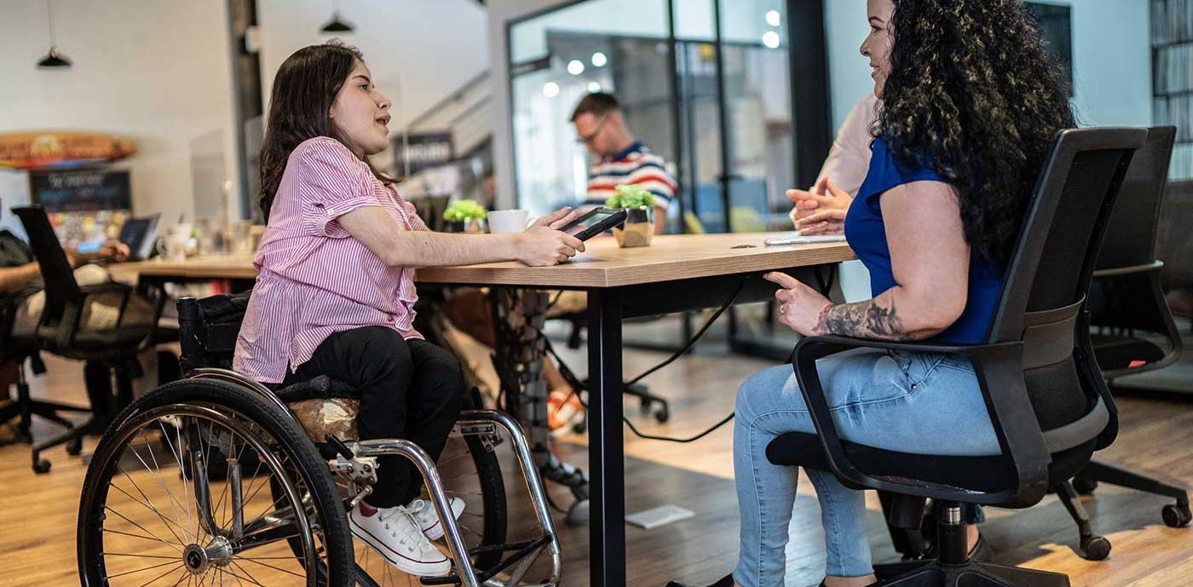

Need for Personal Care Assistance
Explore More Barriers
Notes:
Some people with physical disabilities require personal care assistance to get ready for work and possibly to aid during the workday. To be reliable workers, people with physical disabilities must have reliable personal care assistance. If a caregiver is ill or does not show up, often there is no replacement. This could put a person’s job in jeopardy.

Slide 31

Access to Transportation, Especially Accessible Transportation
Explore More Barriers
Notes:
Transportation is a major employment barrier for anyone who does not drive their own vehicle. In many communities, there very few, if any, transportation options for people who use wheelchairs. Specialized and Paratransit system rides are often expensive and undependable, as well as unresponsive to urgent personal care needs that may develop during the workday. Even if a person can afford to purchase a van, modifications are expensive and may be challenging to justify for long-term care or vocational rehabilitation programs . Maintenance and repair of modified vans can also be extremely expensive.

Slide 32

Employer Attitudes and Negotiating Accommodations
Explore More Barriers
Notes:
Despite the many benefits of hiring people with disabilities, negative stereotypes, and attitudes about disability still exist. Most people with physical disabilities want to work. However, many are aware of the misperceptions that exist among employers and society-at-large regarding the employability of people with physical disabilities. Too often, employers see the disability first and foremost. While the Americans with Disabilities Act (ADA) was viewed by many as a positive piece of legislation, many employers fear that hiring people with disabilities, particularly physical disabilities, will be costly and disruptive to their workforce. People with disabilities may have experienced discrimination and negative attitudes in the workplace. These concerns may inhibit their desire to enter or renter the workforce.
While not all worksites will require accommodations to meet the needs of individuals with physical disabilities, many will. A reasonable accommodation may be architectural in nature (e.g., making the restroom accessible, ramping the entrance, lowering light switches) or may involve equipment or schedule modifications. Often, an individual considering employment for the first time since an injury or illness will have questions and concerns about who will identify, design, and pay for needed accommodations.
There are also myths about workplace accommodations being costly. In fact, 15% of workplace accommodations cost nothing and 50% of accommodations cost less than $500. One study found that 73% of employers surveyed indicated their workers with disabilities did not require accommodations.
People with physical disabilities may need to learn if, how, and when to disclose their disability and how to negotiate reasonable accommodations with an employer.
Sources:
U.S. Department of Labor Office of Disability Employment Policy, Myths and Facts about People with Disabilities
K.A. Dixon, Doug Kruse, Ph.D., and Carl E. Van Horn, Ph.D., “Restricted Access: A Survey of Employers About People with Disabilities and Lowering Barriers to Work,” Work Trends: Americans’ Attitudes About Work, Employers and Government. New Brunswick, N.J.: John J. Heldrich Center for Workforce Development, March 2003, 2

Slide 33
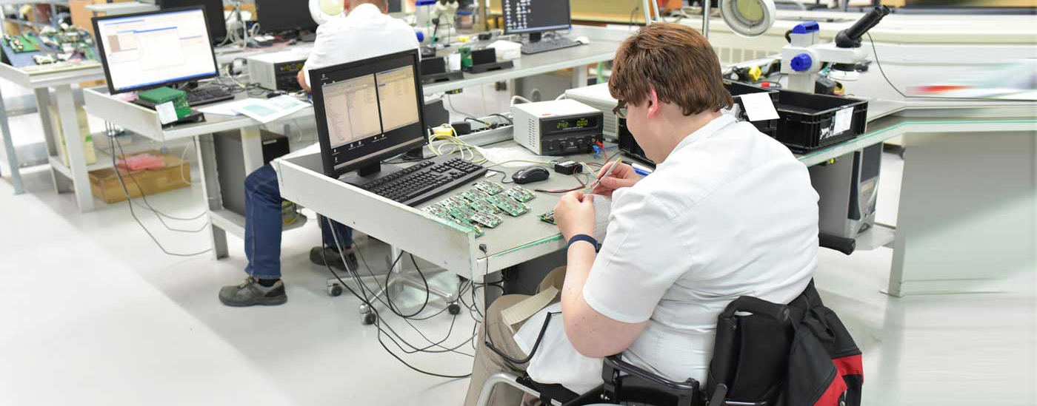
Recap
Notes:
Now that you know about some of the barriers to employment for people with physical disabilities, the next two training modules will describe strategies and resources to address employment barriers.

Slide 34
What You Learned:
Module 1
Employment statistics about people with physical disabilities
Definition of physical disability and physical disability statistics in Wisconsin
How employers benefit from hiring people with disabilities
To identify how unemployment and low income affect physical and mental health
Common barriers to employment that people with physical disabilities experience
Notes:
After completing Module 1 of this training, you can now:
Share employment statistics about people with physical disabilities
Define physical disability and share physical disability statistics in Wisconsin
Describe how employers benefit from hiring people with disabilities
Identify how unemployment and low income affect physical and mental health and
Identify common barriers to employment that people with physical disabilities experience

Slide 35

Thank You
Check out Module 2!
Competitive Integrated Employment for People with Physical Disabilities
Notes:
Thank you for attending the Module 1 training about Competitive Integrated Employment for People with Physical Disabilities. Please continue to Module 2 where you will learn about how to address barriers to employment for people with physical disabilities.

